Slide 1
Week 4: Value to your users

Slide 2
Agenda
Recap of last week’s session: Mission Model Canvas, Product Discovery, Customer Discovery
Product Lifecycle: Zooming out to see the various stages
Value Proposition Canvas: Discovery meets ideation
Where do we go from here? Project RevAMPD

Slide 3
Recap of last week’s session
Mission Model Canvas
Product Discovery
Customer Discovery

Slide 4
To address:
Value risk: Will the beneficiary choose to use this product?
Usability risk: Will the user know how to use this product?
Feasibility risk: Can we build this product?
Business viability: Will this solution work for our business?
PURPOSE OF PRODUCT DISCOVERY
Notes:
This fit is generally termed as product market fit

Slide 5
Design better products
Mitigate usability and value risks
Validate your product ideas
Save costs, time, and effort
WHY DO YOU NEED USER RESEARCH

Slide 6
Conducting user interviews
Identifying use cases
Drafting user flows
Creating personas
Creating journey maps
Usability testing + heuristic evaluations
Recruitment for research participants
USER RESEARCH METHODS THAT WE’LL COVER
Forthcoming
Notes:
Interviews: One-on-one discussions with users to understand how a particular user works. They enable you to get detailed information about a user’s attitudes, desires and experiences.To build consensus about the problem statement and research objectives
Personas are fictional characters based on our research. They represent user types that might use your service, tool, product or site in a similar way. Personas help empathize over the users and are useful to validate our assumptions as we proceed into product development. By creating personas, we were able to move away from distinct user groups and instead think about our user behaviors.
A visualization of the major interactions shaping a user’s experience of a service or a product. To provide teams with a bird’s-eye view of a service that helps them see the sequence of interactions that make up a user’s experience including the complexity, successes, pain points, and emotions that users experience along the way

Slide 7
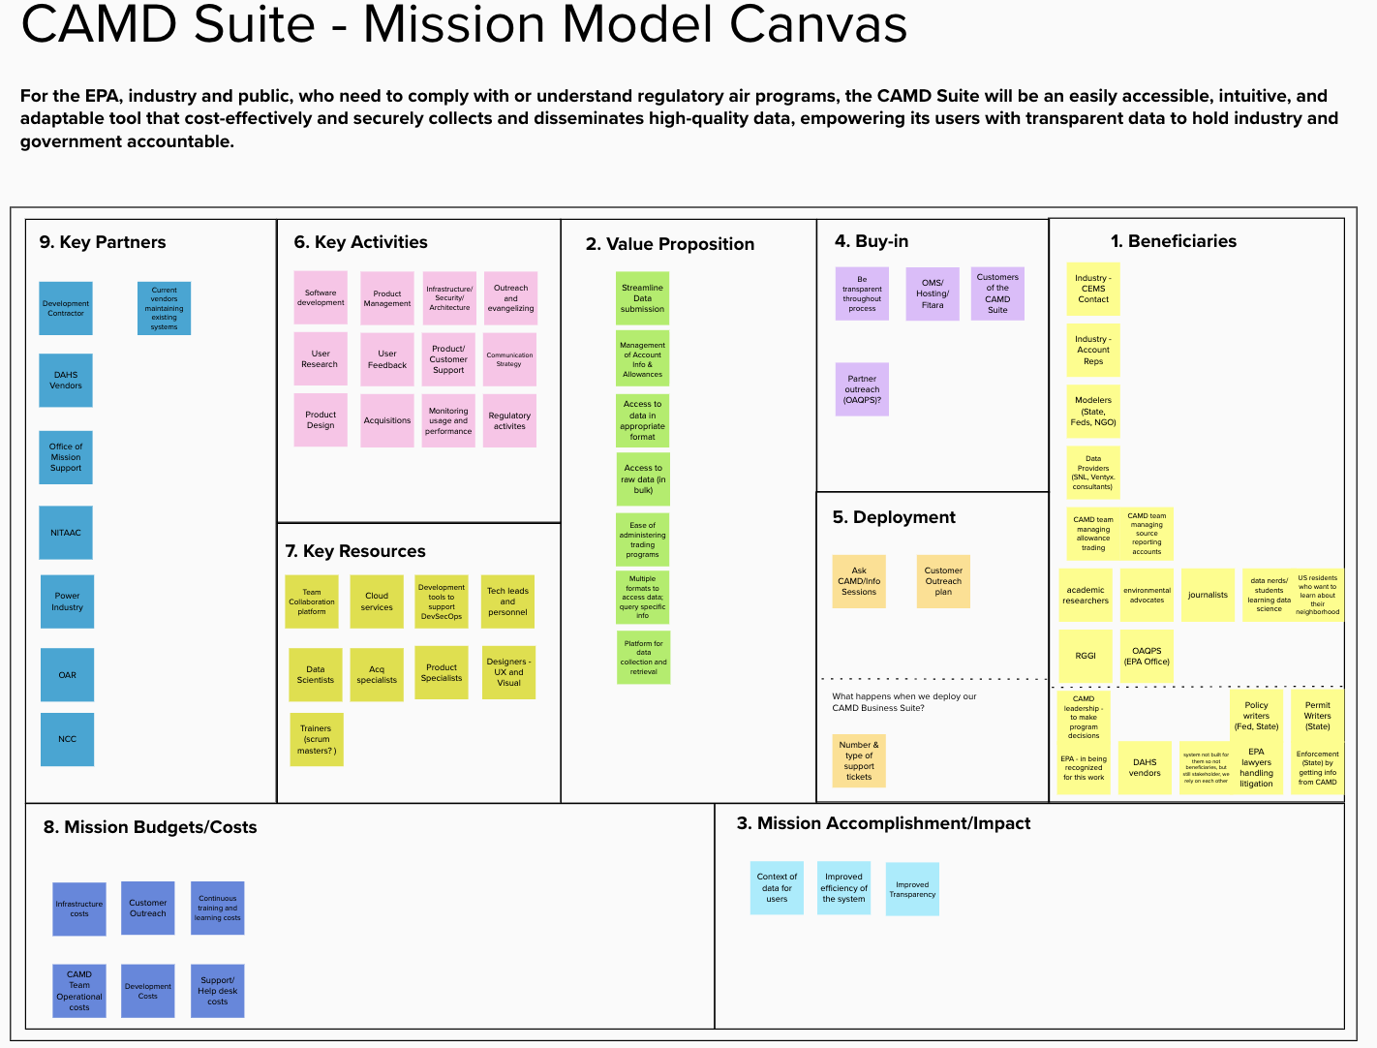
CAMD SUITE - MISSION MODEL CANVAS
Notes:
Execution can include infrastructure issues

Slide 8
A Mission Model Canvas collates information about the customers and beneficiaries, the value proposition, impact, and costs of the product.
WHAT IS A MISSION MODEL CANVAS?

Slide 9
Who do you think should be involved in user research and opportunity assessment? Why?
DISCUSS
Notes:
This fit is generally termed as product market fit

Slide 10
Zooming out

Slide 11
Cross-section of a product life cycle
WHERE ARE WE NOW

Slide 12
Value Proposition Canvas

Slide 13
A Value Proposition Canvas is a framework to visualize, design, and test the value proposition with customers
WHAT IS A VALUE PROPOSITION CANVAS?

Slide 14
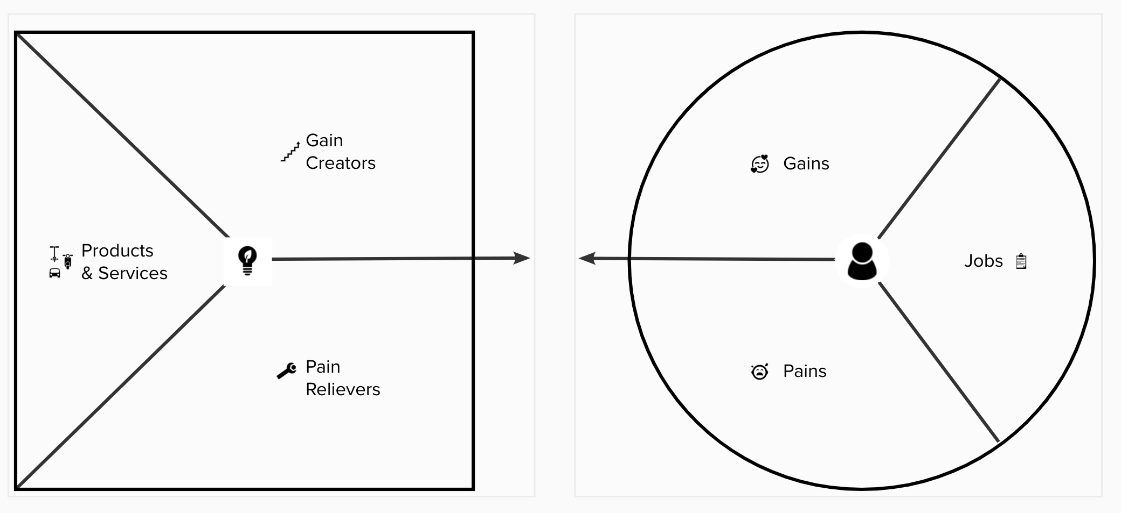
WHAT IS A VALUE PROPOSITION CANVAS?

Slide 15
A Value Proposition Canvas contains both the customer profile and the value proposition
WHAT IS A VALUE PROPOSITION CANVAS?

Slide 16
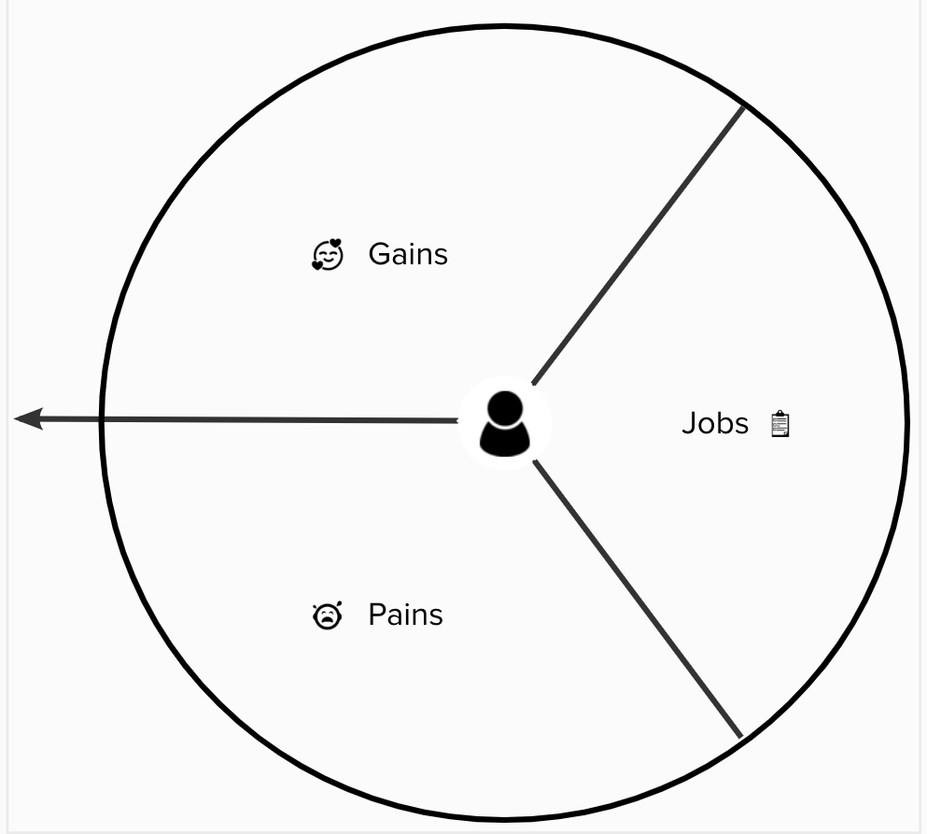
Customer profiles consist of:
Customer jobs
Pains
Gains
WHAT IS A CUSTOMER PROFILE?
Notes:
Jobs can be - tasks, needs with functional, emotional or social intent
Can contain both trivial or
Pains are negative emotions, risks - can be severe or light
Positive outcomes, benefits, surprised, desired, even aspirations
Includes functional utilities, postive gains and emotions or even cost gains

Slide 17
Customer profiles help visualize characteristics of your beneficiaries in more detail
WHAT IS A CUSTOMER PROFILE?
Notes:
Describes the motivation behind why a customer

Slide 18
Customer profiles get clearer as you learn more about your beneficiary segments
WHAT IS A CUSTOMER PROFILE?
Notes:
Describes the motivation behind why a customer

Slide 19
Customer profiles describe the customer’s motivation and need behind using the product
WHAT IS A CUSTOMER PROFILE?
Notes:
Describes the motivation behind why a customer

Slide 20
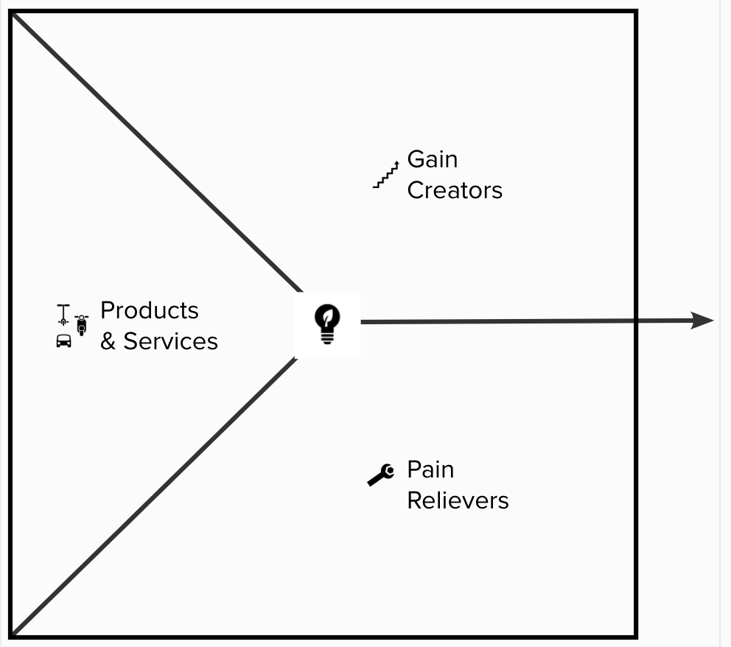
A value proposition consists of:
Products and services
Pain relievers
Gain creators
WHAT IS VALUE PROPOSITION?
Notes:
Products and services
Outline bundles of features that assess user needs
Pain relievers
Speak to ‘how’ their pains are relieved either before, during or after they are trying to get a job done.
Gain:
Speak to ‘how’ customers are

Slide 21
A value proposition is a map describing the value your products/services/features generate for your beneficiary segment
WHAT IS VALUE PROPOSITION?

Slide 22
To identify fit between the products/services you’re developing to help relieve customer pains and deliver gains
WHY USE THE VALUE PROPOSITION CANVAS?
Notes:
This fit is generally termed as product market fit

Slide 23
To prioritize features, products, and services
WHY USE THE VALUE PROPOSITION CANVAS?
Notes:
This fit is generally termed as product market fit

Slide 24
To identify themes among your beneficiaries’ needs/pains to help develop products that maximize value and impact
WHY USE THE VALUE PROPOSITION CANVAS?
Notes:
This fit is generally termed as product market fit

Slide 25
Identifying beneficiary segments: Are your customers who you think they are?
Decrease “waste:” Do your users really have the problems/needs you think they have?
Ideating in silos
Validating ideas early with the right beneficiaries
COMMON PITFALLS THE VALUE PROPOSITION CANVAS HELPS AVOID
Notes:
Creating products/services that do not solve customer needs
Avoid developing products/services that beneficiaries don’t need

Slide 26
1. Create individual canvases for each of your beneficiary segments. Conduct customer research to gather insights into these segments and their pain points.
BEST PRACTICES - VALUE PROPOSITION CANVAS
Notes:
This fit is generally termed as product market fit
DONT - assume the customer pains and gains

Slide 27
2. Look at the Value Proposition Canvas as two independent sections. Customer profiles and their wants and needs are out of your control, whereas the products and services are in your control to define and manage.
BEST PRACTICES - VALUE PROPOSITION CANVAS
Notes:
This fit is generally termed as product market fit

Slide 28
3. Include emotional and social elements/jobs of the customer profile.
BEST PRACTICES - VALUE PROPOSITION CANVAS
Notes:
This fit is generally termed as product market fit

Slide 29
4. DON’T create a customer profile based on the products on hand.
BEST PRACTICES - VALUE PROPOSITION CANVAS
Notes:
This fit is generally termed as product market fit

Slide 30
5. DON’T make it mandatory to map all pains and gains to your products and services.
BEST PRACTICES - VALUE PROPOSITION CANVAS
Notes:
This fit is generally termed as product market fit

Slide 31
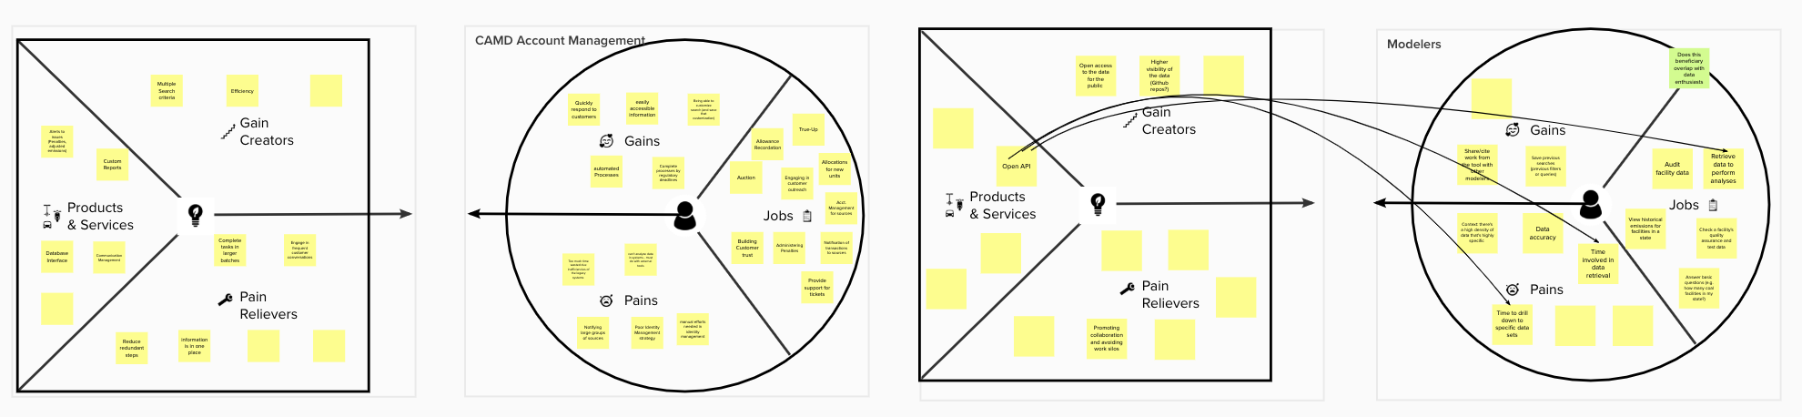
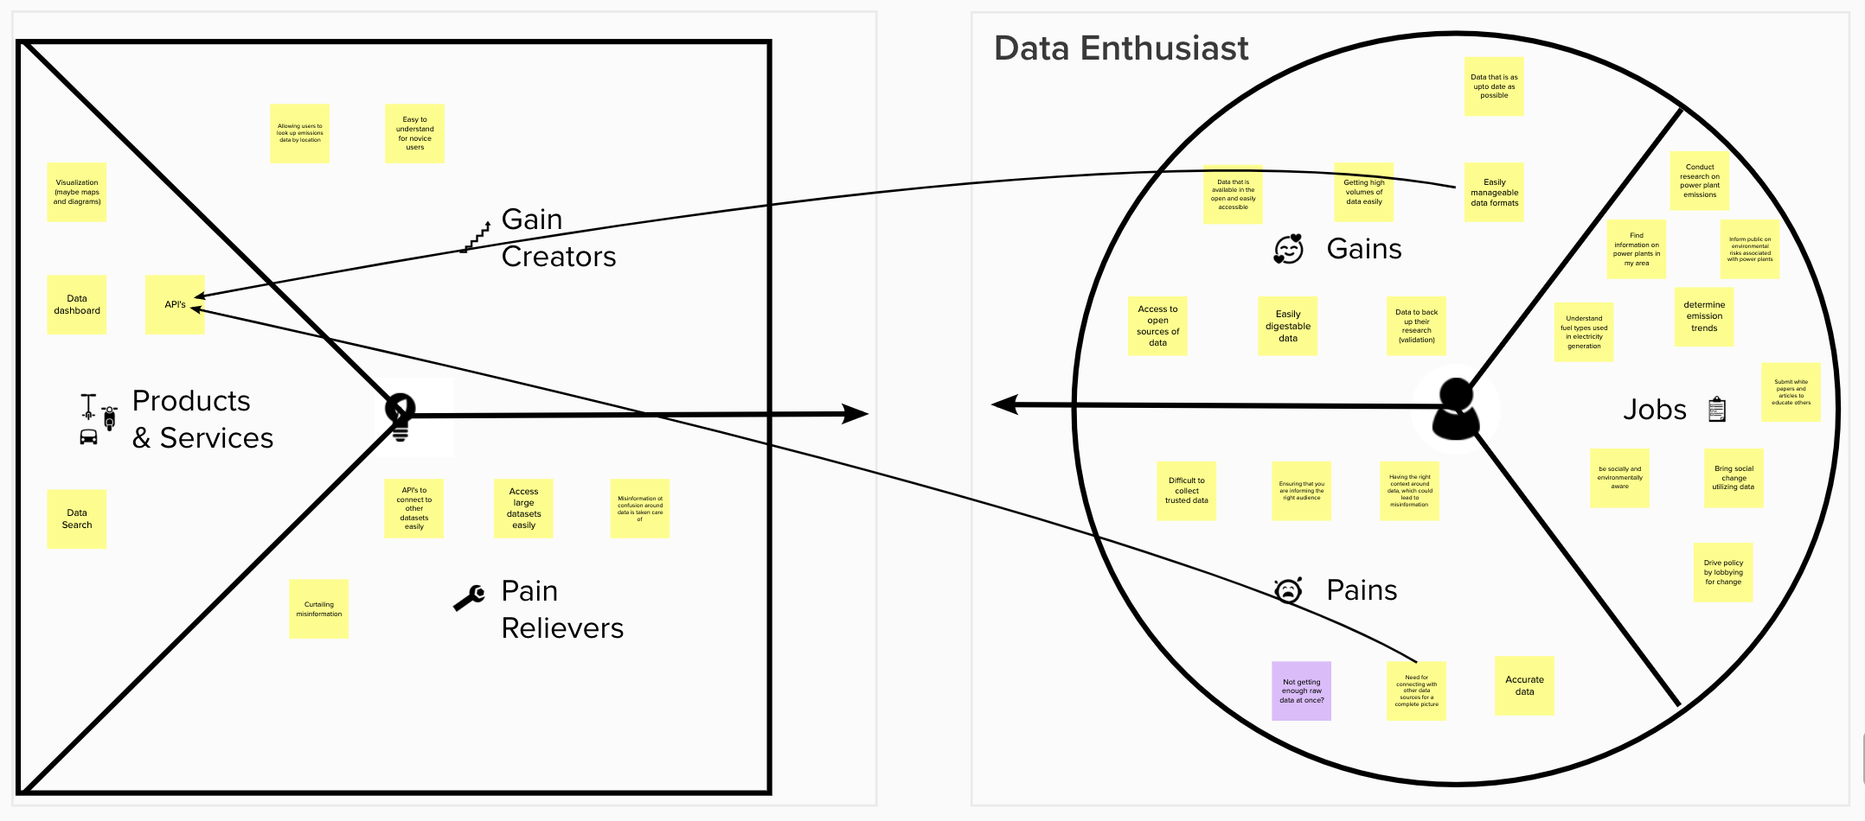
CAMD SUITE - VALUE PROPOSITION CANVAS

Slide 32
Thank you!

